Slide 1
CSE 2102: Introduction to Software Engineering
Software Design
Modules, Interfaces, Implementation

Slide 2
Modules
A software design decomposes a system into a collection of modules.
What is a Module?
  A well-defined component of a software system
  A part of a system that provides a set of services to other modules.
  Services are computations and elements that other modules may rely upon to provide their own services.
Many questions arise about decomposing a software system into modules:
  How to define the structure of a modular system?
  What are the desirable properties of that structure?

Slide 3
Modules: Structure and representation
A software design depicts the relationship among the modules of a system
How to represent the relationships among the modules:
  Mathematical Notation
  Graphical Notation
Mathematical notation may be more concise, however, graphical representation is more intuitive.
  Picture is equivalent to a thousand words!

Slide 4
Mathematical Notation
Let S be a set of modules
S = {M₁, M₂, . . ., M_{n}}
A binary relation r on S is a subset of
S x S
If M_{i} and M_{j} are in S, <M_{i}, M_{j}> ∈ r can be written as M_{i} r M_{j}

Slide 5
Module Relationships
If a relation r is complete (relates all modules to all other modules), then the cardinality of r is n², where n = |S|
If r is null, then no module is related to any other module
Cardinality of r
  0 <= card(r) <= n²
Low cardinality is preferred, Why?
How does low cardinality relate to low coupling?

Slide 6
Graphical Representation
Relations are more intuitively represented by a graph
M
1
M₁ is related to M₂
M₅ is related to M₆
M
2
M
3
M
4
M
5
M
6

Slide 7
Graphical Representation (contd..)
If the relationship graph has no cycles, such a graph is called as a Directed Acyclic Graph (DAG)
The relations among the modules in this case are said to form a hierarchy.
M
1
M
1,1
M
1,2
M
1,3
a DAG
M
1,2,1
M
1,2,2
M
1,2,1,1
M
3
M
2
M
4

Slide 8
The USES Relation
Defined by Parnas
Module M_{i} USES Module M_{j}:
  M_{i} requires the correct operation of M_{j}.
  M_{i} can access the services exported by M_{j} through its interface.
  M_{i} depends on M_{j} to provide its services
    For example, M_{i} calls a routine exported by M_{j}.
  M_{i} is a client of M_{j}
  M_{j} is a server of M_{i}
USES relationship is statically defined.
  Determined at design time rather than execution/runtime

Slide 9
Hierarchy and the USES relation
USES relation should be a hierarchy
A hierarchical USES relations defines a system through multiple levels of abstraction.
  The level of a module is
    0 if that module is used by no other module
    i, where i is the length of the longest DAG path from a level 0 to current module
    M_{i} is at a higher level than M_{j}, iff i > j
Hierarchal uses relation makes the software easier to:
  Understand,
  Apply separation of concerns
  Test -- If USES relation is not a hierarchy, then cycles exist in the module representation graph, and individual modules cannot be tested unless all the modules in the cycle have been implemented. This creates a circular dependency.

Slide 10
Hierarchy and the USES relation
The collection of modules at a particular level of hierarchy compose a virtual or an abstract machine
  Modules at a higher level use this abstract machine to provide necessary services
A system can be thought of as a hierarchy of virtual machines.

Slide 11
Properties of USES Relationship
A software system has no unique design, in fact there are many possible ways of breaking it up into modules.
  Two metrics to measure “how good” is the decomposition.
Fan-out: counts the number of outgoing edges of a module.
  Count of the number of modules used by this module.
Fan-in: counts the number of incoming edges of a module.
  Count of the number of modules using this module.
Low fan-out/high fan-in is desirable:
  Module is a good abstraction used by modules.
  Module does not use or depend on many other modules to offer its services.

Slide 12
The IS_COMPONENT_OF Relation
Used to describe a higher level module as constituted by a number of lower level modules
M_{i} IS_COMPONENT_OF M_{j}
  M_{j} consists of several modules, of which one is M_{i}
M_{j} COMPRISES M_{i}
M_{S,i}={M_{k}|M_{k}∈S∧M_{k} IS_COMPONENT_OF M_{i}} we say that M_{S,i} IMPLEMENTS M_{i}

Slide 13
The IS_COMPONENT_OF Relation (contd..)
A Graphical View
M
M
M
M
M
M
7
8
9
5
6
1
M
M
3
M
4
2
M
M
M
4
2
3
M
M
M
M
M
M
1
7
8
9
5
6
(IS_COMPONENT_OF)
(COMPRISES)
Constitutes a hierarchy – only leaf modules are implemented. M7, M8,
M9, M5, M6 and M4 are implemented.

Slide 14
Conceptual View of a Module
“Services needed” IMPORTED – What does a module need externally?
“Services provided” EXPORTED – What parts of the module others can
use?
“CODE” - Implementation of functions
END

Slide 15
Example of a module
MODULE CASH_REG
{
SCANNER
KEYPAD
DISPLAY
DB of Prices
LINKS to ATMs, CCs etc.
IMPLEMENTATION
}
S
Inside module
K
D
Outside module
“Imported”
IImportt
Impl

Slide 16
Pictorial view of modules
MODULE table
MODULE buffer
procedure insert;
procedure find;
const limit;
var tab, avail;
……
procedure bodies
initialization
Public interface
procedure enter;
procedure leave;
const nul;
const maxbuf;
var size, front…
procedure succ;
….
procedure bodies
….
initialization
Private impl.

Slide 17
Modules: Interface vs. Implementation
Interface:
  Public portion, or the portion accessible outside the module.
  Provides information about what services the module offers.
  Hides how those services are implemented.
  Clients only need to see the interface to use the module.
  Module is said to “export” the services.
  Client, or the user of the module “imports” the services.
  Acts as a contract between the module and its clients.
Implementation:
  Private portion, or the portion accessible inside the module.
  “How” the exported service is implemented.
  Implementation is hidden from the clients, may be composed of other modules of actual code.
Separation of concerns is supported by division between a module’s interface and implementation

Slide 18
Modules: Interface vs. Implementation
To understand the nature of USES, we need to know what a used module exports through its interface
  The client imports the resources that are exported by its servers
  Modules implement the exported resources
Implementation is hidden to clients

Slide 19
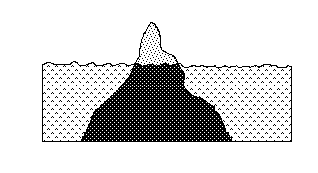
Modules: Interface vs. Implementation (contd..)
Interface is like the tip of the iceberg, why?
It is possible for a ship to avoid an iceberg by simply viewing the tip. Similarly, it should be possible for a client to use a module by simply knowing its interface.

Slide 20
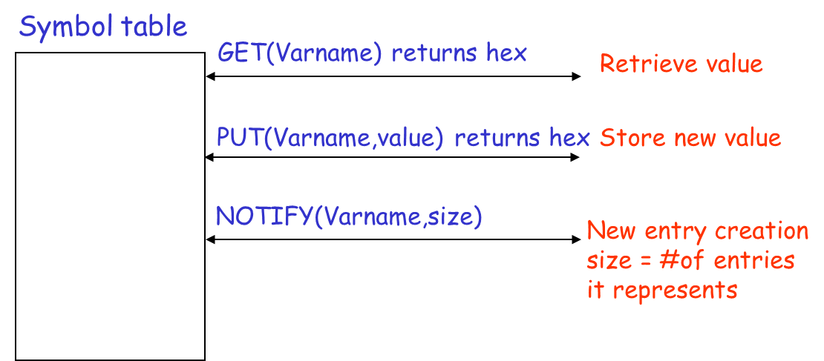
Modules: Interface vs. Implementation (contd..)
Interpreter for a very simple programming language.
Language operates on integers and integer variables.
Symbol table module -- stores information about the variables for a program. It exports three procedures:
- “GET” – Input is the symbolic name of a variable and an index if the variable is an array, and returns the value.
- “PUT” – Stores a new value for a given variable.
- “NOTIFY” – Creates a new entry when a new variable is encountered.

Slide 21
Modules: Interface vs. Implementation (contd..)
What happens if the GET function returns the location of the variable in addition to its value?
  A client module could use the location of the variable to directly manipulate it, rather than using PUT.
  If new variables are added, or old ones are deleted, then the returned location would no longer be correct.
  Manipulating the variable through its location directly would thus cause unintended consequences.

